Slide 1


Building Robust ETL Pipelines with Power BI Dataflows

Slide 2




Tony McGovern
Hacker. Artist. Storyteller. Data lover.
Founder & Data Scientist
emdata.ai
@tonmcg

Slide 3

A SHIFT FROM SKILLS TO STRATEGY
ACADEMIC RESEARCHER
DATA SCIENTIST
1970s
1990s
Today
1980s
2000s
STATISTICIAN
PhD SCIENTIST
AUTOMATED AI

Slide 4

Session Objectives
Understand the importance of the low- and no-code ETL capabilities of Power BI Dataflows
Notes:
Choose the right Azure machine learning product for the task at hand
- do you need to deploy the model and constantly monitor and update it?
- do you need to choose among a selection of models?
Right-size the Azure machine learning services to fit your data science team
- Are you going to do ETL in Azure Data Factory or in Azure Databricks?
- Which service is right if I only have one data scientist?

Slide 5
Agenda
Introduce Power BI Dataflows
Demo: Load data into Power BI Dataflows
Demo: Reuse Power BI Dataflows
Epilogue: Enable AI features of Power BI

Slide 6
Building Robust ETL Pipelines with Power BI Dataflows

Slide 7
Introduce Power BI Dataflows

Slide 8
What is a Dataflow?
Dataflow is a Power Query process that runs in the Power BI service independently from any Power BI report

Slide 9
What is a Dataflow?
Power Query in the Cloud
Runs on the Power BI service
Runs independently of Power BI datasets
Allows for sharing:
Datasets across Workspaces
Allows for reuse:
Datasets within data models
Data engineering pipelines through JSON schemas
Notes:
Power Query in the Cloud
Execution of Power Query mashups are done on the Power BI service, which means runtime is not limited by your laptop
Run independently of Power BI datasets, which are loaded into the in-memory storage of Power BI
And can be scheduled at different frequencies
Allows you to share datasets across Power BI Workspaces
Allows you to reuse:
Datasets within data models
Data engineering pipelines
TAKEAWAY: It closes the gap between IT and business needs

Slide 10
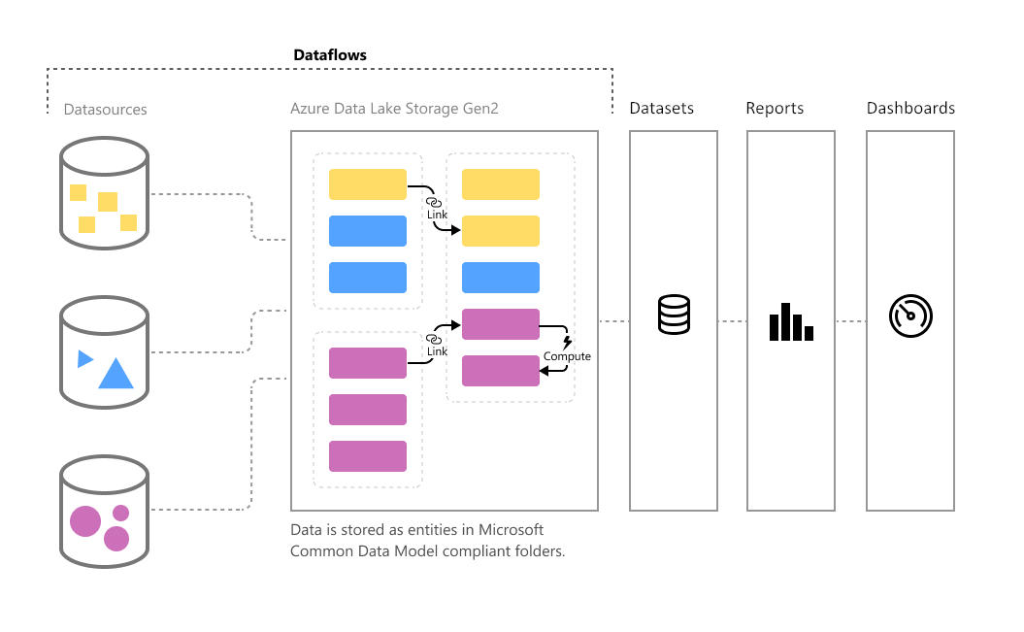
Where is a Dataflow Stored?
Notes:
Backed by Azure data storage (CSVs on Azure Data Lake Gen2)
This is behind the scenes: Dataflow manages the Data Lake configurations
It won’t cost you a penny
TAKEAWAY: Power BI dataflows use Azure Data Lake free of charge

Slide 11
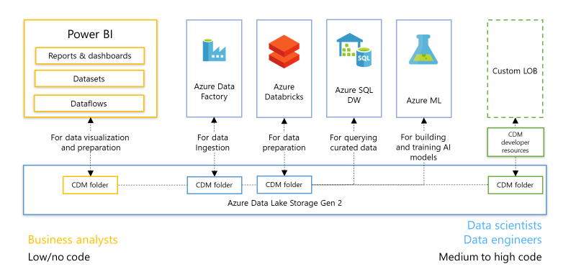
Where is a Dataflow Stored?
Notes:
More and more of data analytics makes use of data lakes
Allows you to bring your own data lake and make connections to that
TAKEAWAY: Dataflows is part of a Data Analytics continuum that lets you easily scale up

Slide 12
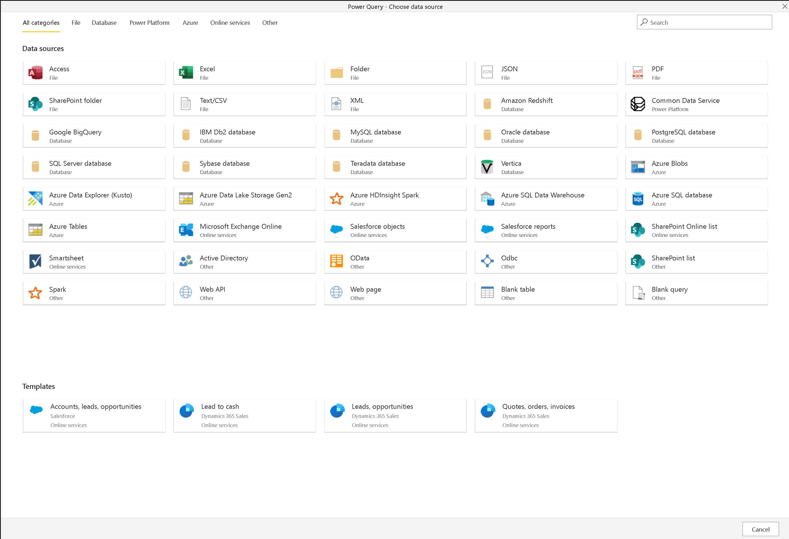
What Can a Dataflow Connect To?
Notes:
Like Power Query in Power BI, Dataflows comes with hundreds of native connectors
Any missing native connectors can be made possible through Web.Contents
TAKEAWAY: Power BI dataflows can connect to any system you connect to in Power BI

Slide 13
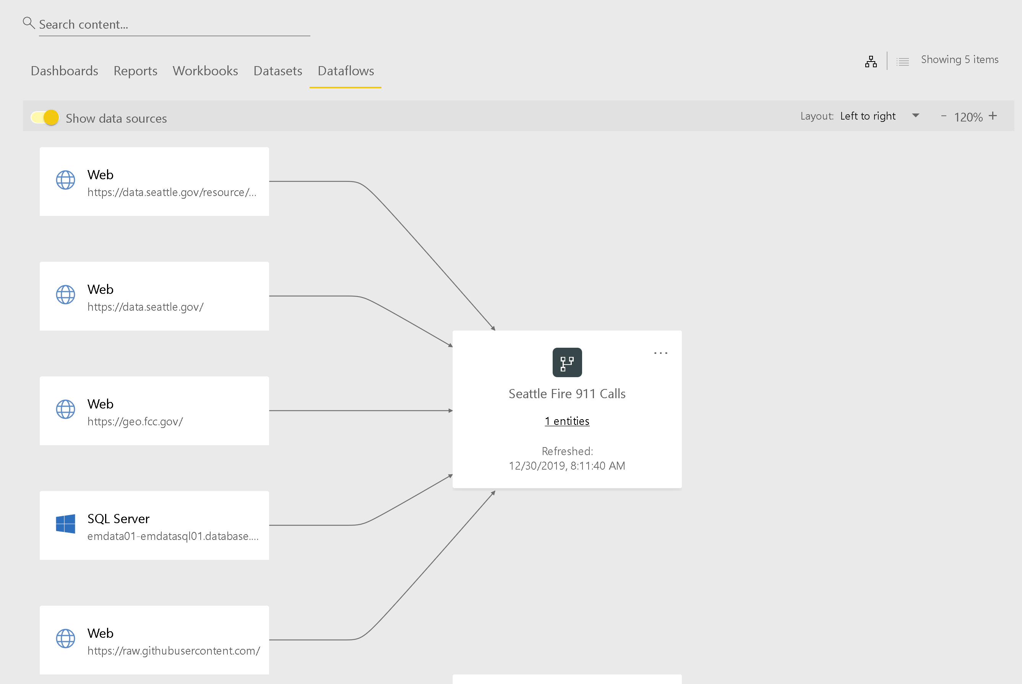
What Can a Dataflow Connect To?
Notes:
Preview: here’s a Dataflow that connects to an Azure SQL Server, three APIs, and a GitHub repo
TAKEAWAY: Power BI dataflows can connect to any system you connect to in Power BI

Slide 14
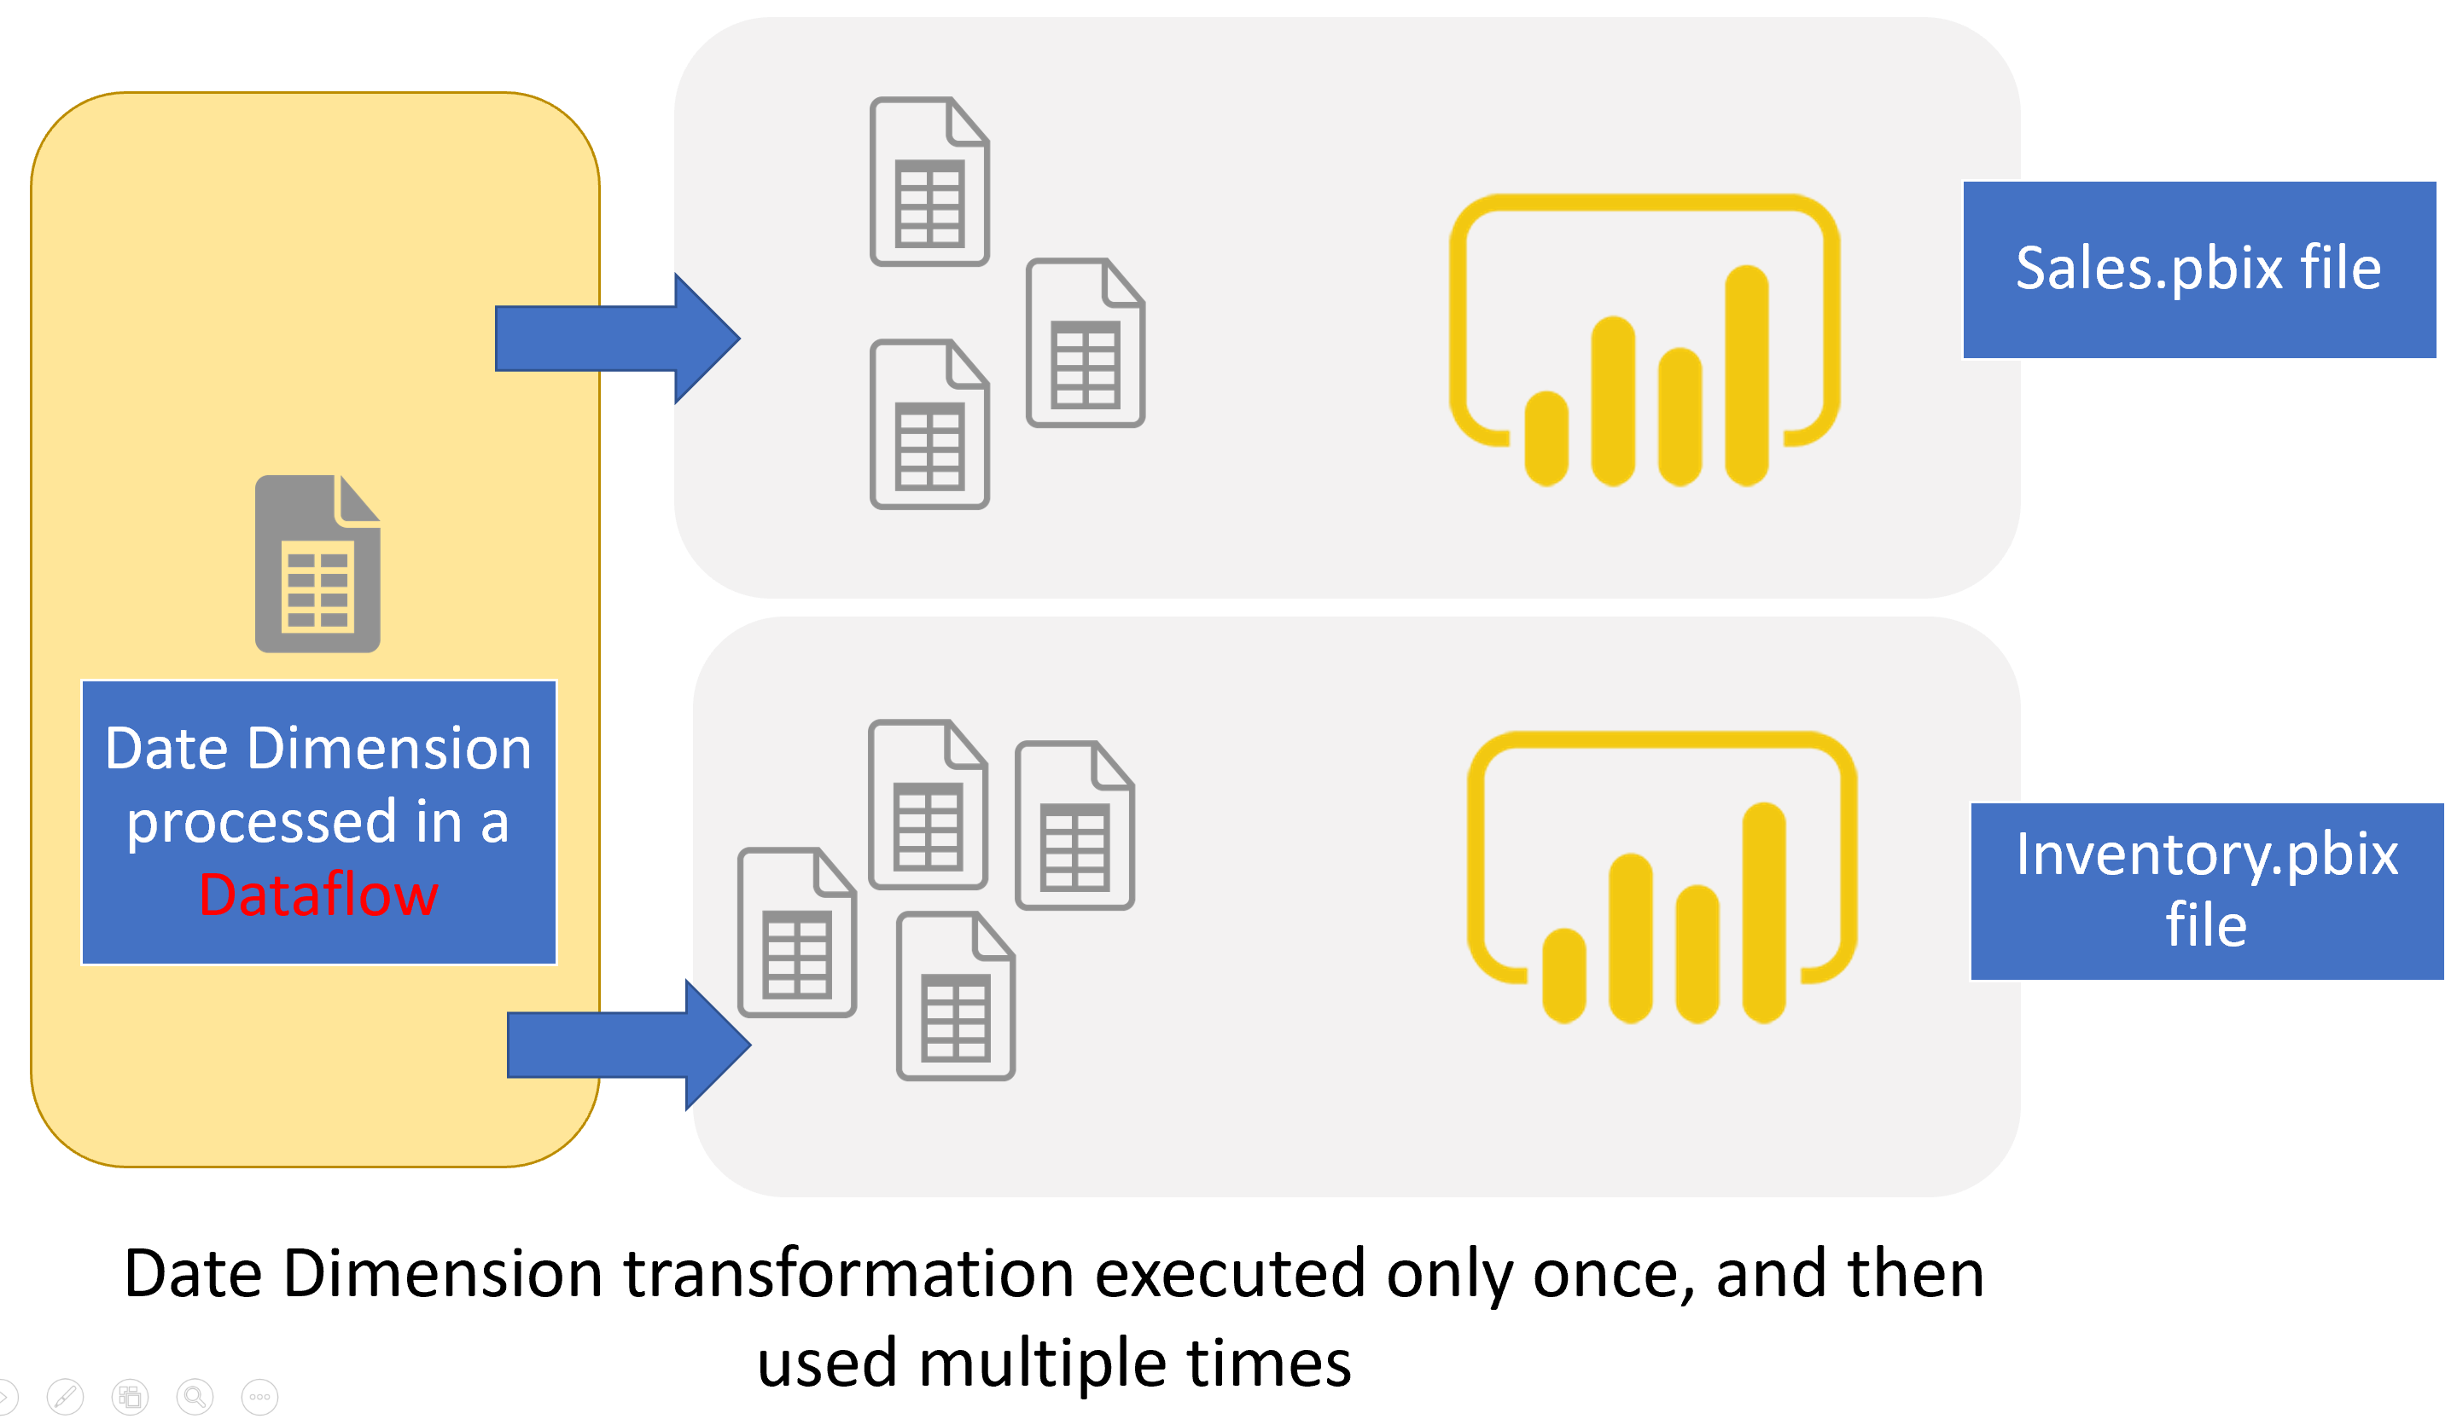
How Can a Dataflow Be Reused?
Notes:
Once a dataflow entity has been created, it can be shared across any number of Power BI reports
TAKEAWAY: Add your data to a source to make it more usable and relevant to you and your team

Slide 15
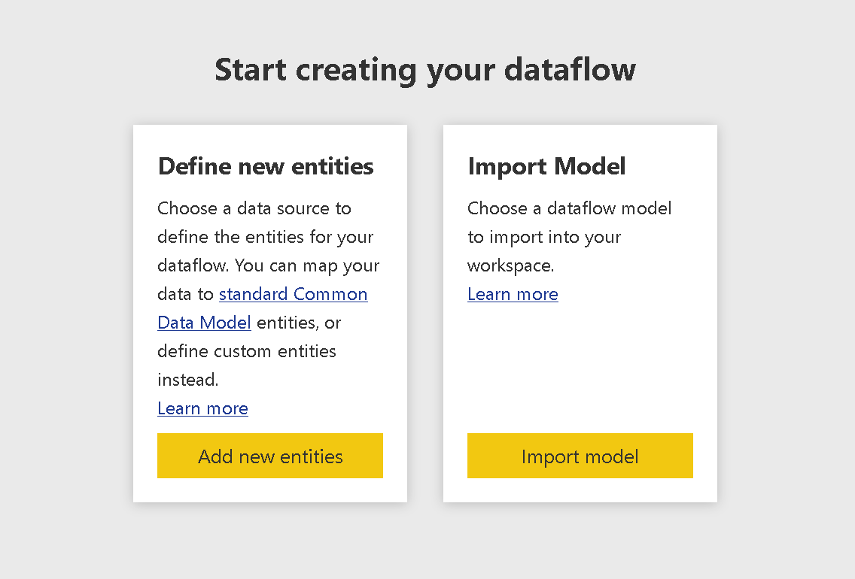
How Can a Dataflow Be Reused?
Notes:
Once a dataflow has been created on the service, it can be exported to a JSON file and shared across workspaces and even tenants
TAKEAWAY: Define a Power BI dataflow once and use it anywhere dataflows are sold

Slide 16
Demo: Load Data into Power BI Dataflows

Slide 17
Demo: Reuse Power BI Dataflows

Slide 18
Epilogue: Enable AI features of Power BI

Slide 19
Resources
Power BI dataflows: Where does it fit in? (Matthew Roche schools Patrick)
https://www.youtube.com/watch?v=lXq9GDfpv0Y
What are the Use Cases of Dataflow for You in Power BI
https://www.youtube.com/watch?v=jBP66FRatsY
What is a Power BI dataflow? A deep dive on Dataflows for Power BI
https://www.youtube.com/watch?v=bkFG8s_9sGE
Three Ways to Use Power BI Dataflows
https://www.sqlchick.com/entries/2019/3/28/three-ways-to-use-power-bi-dataflows
Self-service data prep in Power BI
https://docs.microsoft.com/en-us/power-bi/service-dataflows-overview
Power BI Dataflows and Azure Data Lake Storage Gen2 Integration Preview
https://powerbi.microsoft.com/en-us/blog/power-bi-dataflows-and-azure-data-lake-storage-gen2-integration-preview/

Slide 20


